Slide 1
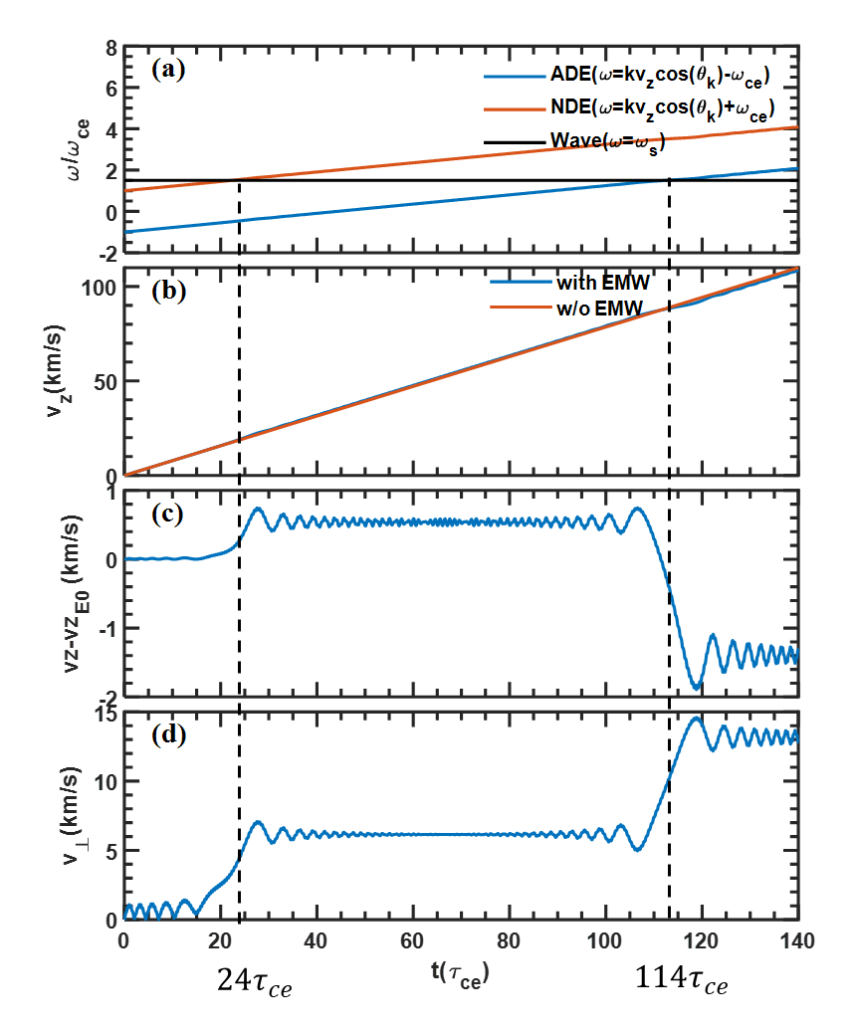


$$24τ_{ce}$$
$$114τ_{ce}$$

Slide 2
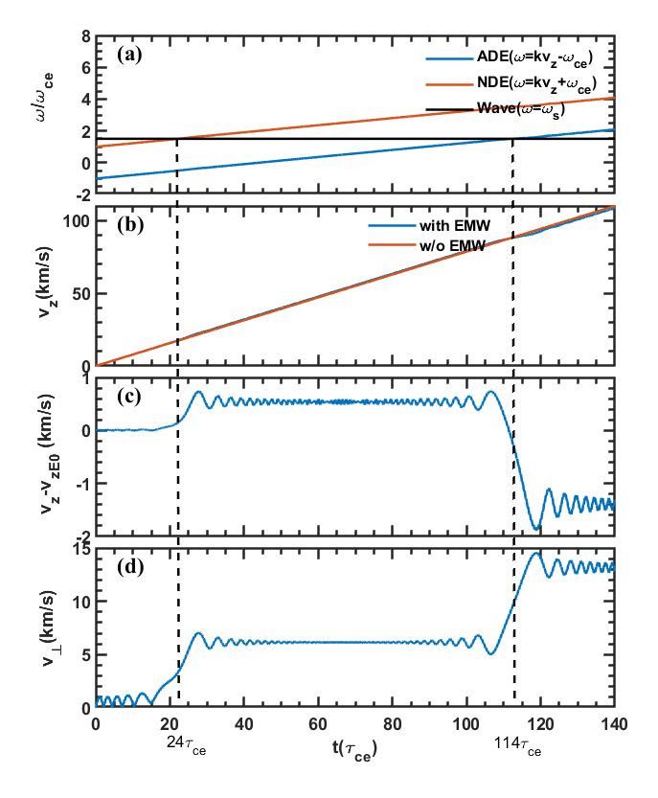


$$24τ_{ce}$$
$$114τ_{ce}$$

Slide 3
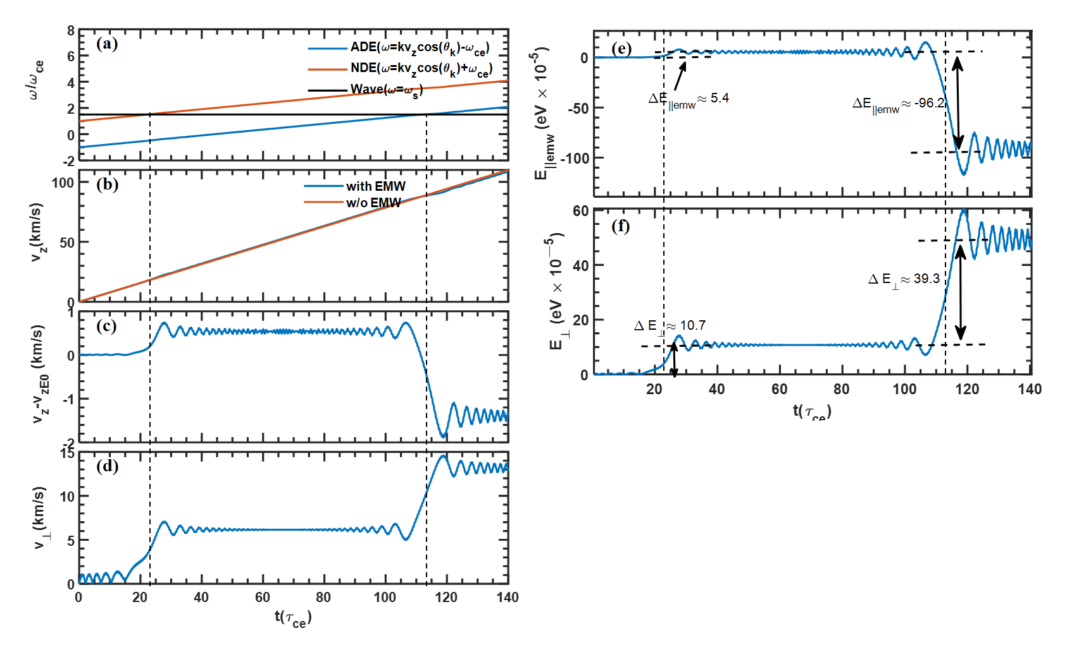

Slide 4
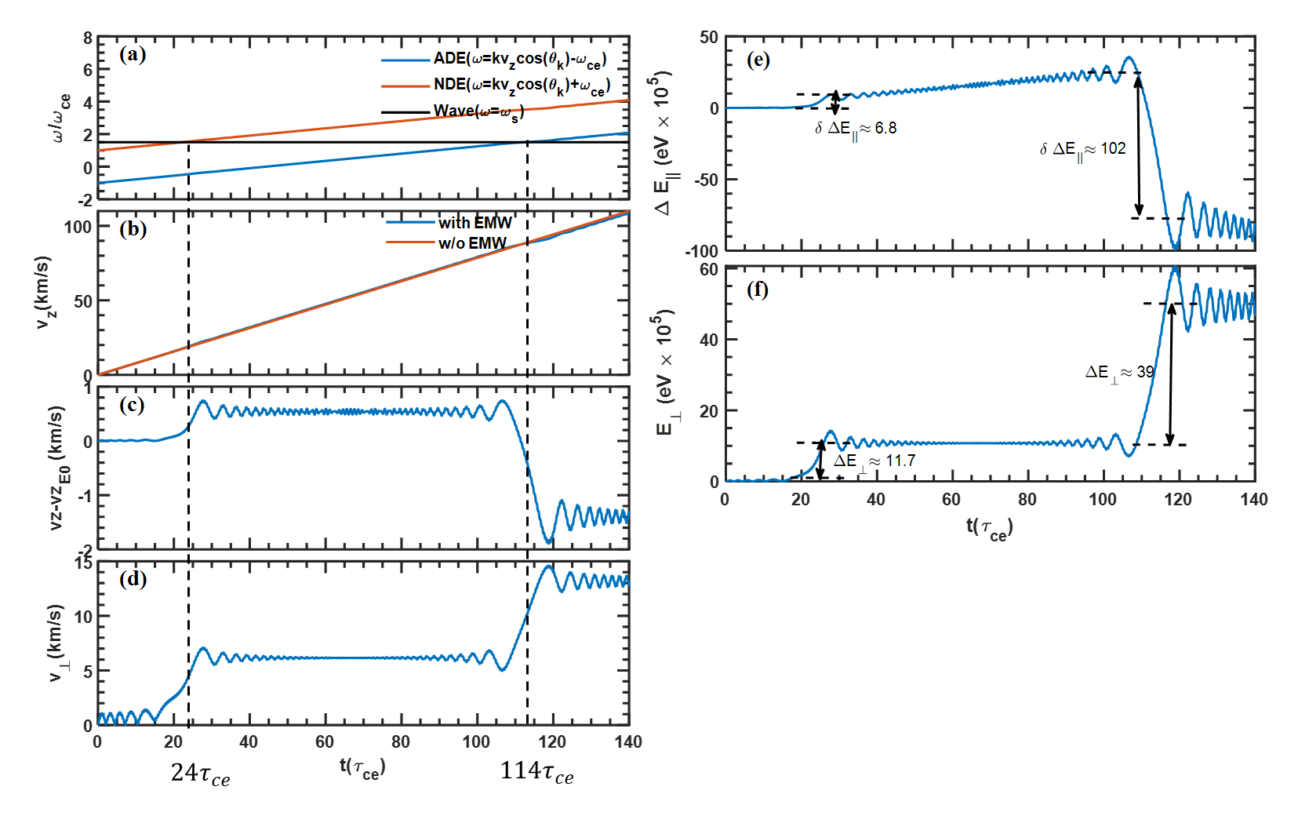

Slide 5



0
$$\frac{ω−ω_{ce}}{k}$$
$$\frac{ω}{k}$$
$$\frac{ω+ω_{ce}}{k}$$

Slide 7
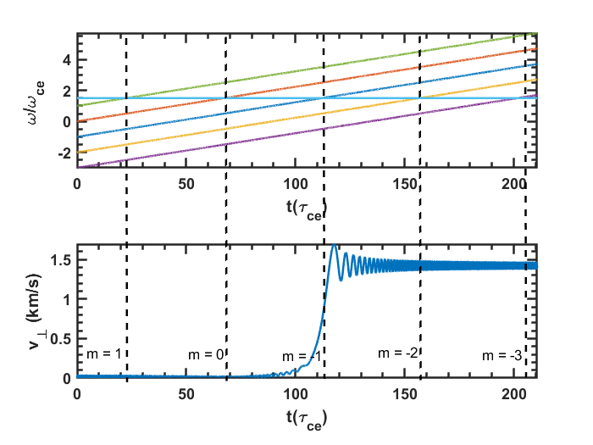
(a)
(b)

Slide 8



$$\vec{k}$$
$$θ_{0}$$
$$\vec{v}$$

Slide 9

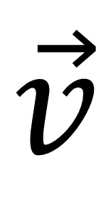

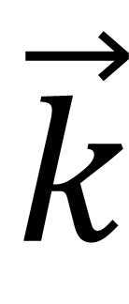
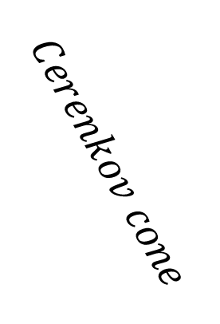
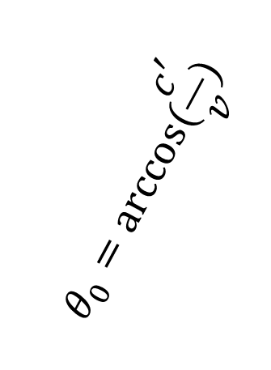
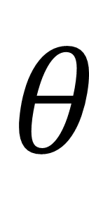
$$\vec{k}$$
$$θ_{0}=arccos⁡(\frac{c^{′}}{v})$$
$$θ$$
$$\vec{v}$$
$$Normal Doppler Effect (NDE)$$
$$Anomalous Doppler Effect (ADE)$$
$$Cerenkov cone$$

Slide 10
